Slide 1
RDC and Mac layers in Contiki
Jacques Tiberghien, Kris Steenhaut
Remark: all numerical data refer to the parameters defined in IEEE802.15.4 for 32.5 Kbytes/s transmission in the 2.4 GHz frequency band.
All Contiki experiments were done with Version 2.6

Slide 2
Contiki Communication stack Conceptual view
M2P / P2M
P2P
TCP/UDP
IPV6+RPL
6LoWPAN
MAC
RDC
Physical Layer
IEEE 802.15.4 Phy
Notes:
The Net subsystem of Contiki implements the communications facilities. This slide shows the simplified layered structure. Two different communication stacks are available: rime and UIP6.
The rime stack offers simple, Contiki specific, communication facilities, including single-hop unicast (P2P) or broadcast (BROAD) and multi-hop multipoint to point (M2P) functionality.
The UIP6 stack offers, multi-hop multipoint to point (M2P), point to multipoint (P2M) and point to point (P2P) functionality via the RPL routing protocol. By bypassing the transport and network layers, single hop unicast (P2P) and broadcast (BROAD) functionality is also available.
The MAC, RDC and physical layers are common to both stacks, but their code contains many if(IPV6) and if(!IPV6) statements.
The RPL routing protocol uses additional information about links gathered by the MAC and RDC layers.
The MAC and RDC protocols use additional information provided by the physical layer (ex: Channel Clear detection by the cc2420 hardware)

Slide 3
Zoul Radio Architecture
CPU
Rx
128 bytes FIFO
31 250 Bytes/s
Tx
128 bytes FIFO
CC2538
Tx:
FL + MPDU (-FCS) in FIFO
FIFO underflow detection
FCS calculation & insertion
PHY header addition
Encoding & modulation
Sending ack frames
Retransmitting frames
Rx:
Receiver synchronization
Demodulation & decoding<
Discarding PHY header
CCA, RSSI and LQI evaluation
Discarding corrupted frames
Address based frame selection
Generation of ACK frames
FL+MPDU-FCS+RSSI+LQI in FIFO
CPU performs higher level MAC functions not supported by the radio (Frame Length, Radio Duty Cycle, …)
Notes:
The Zoul motes use the cc2538 microchip, containing a radio and a CPU. The transfer of data between the CPU in the mote and the radio is done through two 128 byte FIFO stores.
To transmit a frame, the computer loads the length of the frame (FL) and its contents, without FCS, in the FIFO buffer. The transmitter adds the 5 bytes of the physical header and the two bytes of the FCS, encodes everything and transmits the frame. If requested, the transmitter keeps the contents of the FIFO buffer and retransmits repeatedly the frame.
The receiver checks for incoming radio signals (Clear Channel Assessment), decodes the received signal, computes the RSSI and LQI figures and checks the FCS field. If, according to the FCS, the frame is corrupt, it is discarded. Otherwise, the destination address in the received frame is compared with the address of the receiver and if they match, the frame is pushed in the receiver FIFO. In this FIFO the two bytes of the FCS are replaced by the values of RSSI and LQI computed while the frame is being received. When a frame with the Ack request bit on is received, the receiver instructs directly the transmitter to send an Ack frame (and to stop retransmitting the frame kept in the transmitter FIFO).

Slide 4
Transmitter byte encoding
31 250 Bytes/s = 250 kbit/s
Symbol delimiter
Each byte is split into two four bit “symbols”.
62 500 Symbols/s
Pseudo-random Sequences
(16 different sequences of 32 bits, called “chips” )
Symbol encoding
2 000 000 Chips/s
Modulator
Each chip is encoded by half a period of a sine
500 KHz phase modulated sine waves in quadrature.
Notes:
The transmitter uses spread spectrum technology for transmitting data. It works at a fixed speed of 31 250 bytes per second. Each byte is split into two 4 bit entities, called “symbols”. Each symbol is encoded by means of a predetermined sequence of 32 bits. Those bits are also called chips. This results in a transmitted chip rate of 2 Mb/s. By transmitting 8 times more bits (chips) as there is information to be transmitted, one uses a lot of bandwidth to transmit a small quantity of information, meaning that, according to the theorem of Shannon, the signal to noise ratio of the radio channel can be low or one can say that you trade bandwidth for better noise immunity.

Slide 5
IEEE 802.15.4 symbol-to-chip mapping
Symbol | Chip sequence (C0, C1, C2, … , C31)
0000 | 1 1 0 1 1 0 0 1 1 1 0 0 0 0 1 1 0 1 0 1 0 0 1 0 0 0 1 0 1 1 1 0
0001 | 1 1 1 0 1 1 0 1 1 0 0 1 1 1 0 0 0 0 1 1 0 1 0 1 0 0 1 0 0 0 1 0
0010 | 0 0 1 0 1 1 1 0 1 1 0 1 1 0 0 1 1 1 0 0 0 0 1 1 0 1 0 1 0 0 1 0
0011 | 0 0 1 0 0 0 1 0 1 1 1 0 1 1 0 1 1 0 0 1 1 1 0 0 0 0 1 1 0 1 0 1
0100 | 0 1 0 1 0 0 1 0 0 0 1 0 1 1 1 0 1 1 0 1 1 0 0 1 1 1 0 0 0 0 1 1
0101 | 0 0 1 1 0 1 0 1 0 0 1 0 0 0 1 0 1 1 1 0 1 1 0 1 1 0 0 1 1 1 0 0
0110 | 1 1 0 0 0 0 1 1 0 1 0 1 0 0 1 0 0 0 1 0 1 1 1 0 1 1 0 1 1 0 0 1
0111 | 1 0 0 1 1 1 0 0 0 0 1 1 0 1 0 1 0 0 1 0 0 0 1 0 1 1 1 0 1 1 0 1
1000 | 1 0 0 0 1 1 0 0 1 0 0 1 0 1 1 0 0 0 0 0 0 1 1 1 0 1 1 1 1 0 1 1
1001 | 1 0 1 1 1 0 0 0 1 1 0 0 1 0 0 1 0 1 1 0 0 0 0 0 0 1 1 1 0 1 1 1
1010 | 0 1 1 1 1 0 1 1 1 0 0 0 1 1 0 0 1 0 0 1 0 1 1 0 0 0 0 0 0 1 1 1
1011 | 0 1 1 1 0 1 1 1 1 0 1 1 1 0 0 0 1 1 0 0 1 0 0 1 0 1 1 0 0 0 0 0
1100 | 0 0 0 0 0 1 1 1 0 1 1 1 1 0 1 1 1 0 0 0 1 1 0 0 1 0 0 1 0 1 1 0
1101 | 0 1 1 0 0 0 0 0 0 1 1 1 0 1 1 1 1 0 1 1 1 0 0 0 1 1 0 0 1 0 0 1
1110 | 1 0 0 1 0 1 1 0 0 0 0 0 0 1 1 1 0 1 1 1 1 0 1 1 1 0 0 0 1 1 0 0
1111 | 1 1 0 0 1 0 0 1 0 1 1 0 0 0 0 0 0 1 1 1 0 1 1 1 1 0 1 1 1 0 0 0
Notes:
This table gives for all 16 possible symbols, the corresponding chip sequence.
This is in fact an example of spread spectrum. Faster chipstream needs more bandwidth than the original bitstream and is because of that offering more noise immunity.
Also, the coding acts as an error correcting code for the chip-based messages (see course advanced IT-networks or course telecommunications). In the full space of possible messages of 32 bits, the messages that are sent by the sender are only a small subset in the set of all possible 32 chip messages.
The chip-based messages will be at a hamming distance that is large enough to correct at least a single chip error or even more => check Hamming distance between the chip-based messages to see how many incorrectly received chips can be corrected.

Slide 6
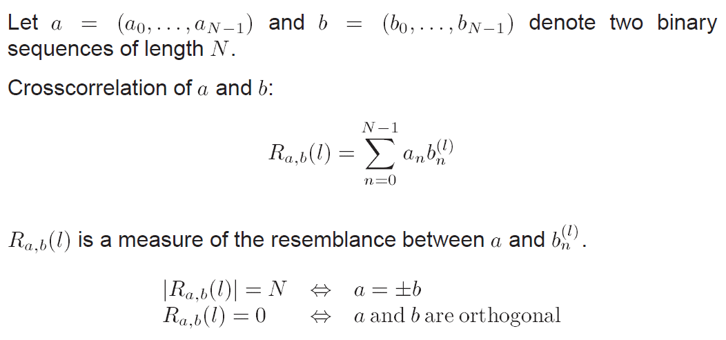
Cross-correlation of binary sequences
Notes:
How to calculate correlation? In this a 0 is seen as ( -1 ) and a 1 as (+1).

Slide 7
Receiver byte decoding
Contents of received frame.
Frame assembler
Pseudo-random Sequences
(16 different sequences of 32 bits, called “chips” )
Symbol correlator
LQI (Link Quality Indicator)
Frame delimiter
Demodulator
RSSI (Received Signal Strength Indicator), CCA (Clear Channel Assessment)
500 KHz phase modulated sine waves in quadrature.
Notes:
The receiver evaluates the level of incoming radio energy. This is used to generate the “Clear Channel Assessment” binary information and the RSSI figure associated with each received frame.
Next the incoming chips are correlated with the 16 pseudo random sequences representing the 16 possible symbols and the symbol yielding the highest correlation with the incoming message is selected. The LQI figure is the value of the correlation between received symbol and symbol produced at the sender and gives an indication of the quality of the digital radio link.
The correlation between two chip/bit sequences is calculated as shown in the previous slide.

Slide 8

CC2538 Radio
Tx output: software selectable between 0dBm and – 24dBm.
Rx input: Minimum input signal = - 97 dBm.
Maximum input signal = + 7 dBm.
Received Signal Strength Indicator (RSSI) :
Average of the signal power at input of receiver Measured over 8 last received symbols (128 µS). Error : +/- 4 dB
Linearity : +/- 1 dB
Notes:
dBm or dB_{mW} (decibel-milliwatts) is a unit of level used to indicate that a power level is expressed in decibels (dB) with reference to one milliwatt (mW). dBm or dB_{mW} (decibel-milliwatts) is a unit of level used to indicate that a power level is expressed in decibels (dB) with reference to one milliwatt (mW). To express an arbitrary power P in mW as x in dBm, the expression shown on the slides can be used.
In telecommunications, received signal strength indicator (RSSI) is a measurement of the power present in a received radio signal.
The output level of the CC2538 transmitter can be adjusted between 0 and -24 dBm.
The receiver can work properly with input signals between +7 dBm and -97 dBm.
A power level of 0 dBm corresponds to a power of 1 milliwatt. A 10 dB increase in level is equivalent to a 10-fold increase in power. Therefore, a 20 dB increase in level is equivalent to a 100-fold increase in power. A 3 dB increase in level is approximately equivalent to doubling the power, which means that a level of 3 dBm corresponds roughly to a power of 2 mW. Similarly, for each 3 dB decrease in level, the power is reduced by about one half, making −3 dBm correspond to a power of about 0.5 mW.

Slide 9
CC2538 Radio
Clear Channel Assessment (CCA) : measured over 128 µS
3 conditions can be selected:
- Received signal below predefined threshold.
- Not receiving an IEEE802.15.4 frame.
- Both above conditions simultaneously.
Default threshold = -77 dBm
Link Quality Indication (LQI):
Average of the correlation values obtained when the 8 first symbols of 32 chips are identified (32X8/2= 128)
Excellent : 110
Minimal : 55

Slide 10
Address Field Handling
The IEEE 802.15.4 MAC frame has:
Provisions for sender and/or receiver addresses
Provisions for 16 (MIME) or 64 bit (6LoWPAN) addresses
Receiver Address = “all F” for broadcast frames
CC2538 receiver can filter frames in function of addresses:
leave in Rx FIFO only
- frames from specified sender
- frames with specified receiver address
- broadcast frames

Slide 11
802-15-4 Frame Format
Frame Payload (<=102 bytes)
Address Information (0 to 20 bytes)
Data Sequence Number (1 byte)
Frame Control Field (2 bytes)
Frame Check Sequence (2 bytes)
MAC Protocol Data Unit (6 to 127 bytes)
Frame Length (1 byte)
Start of Frame Delimiter (1 byte)
Preamble (4 bytes)
PHY Protocol Data Unit (12 to 133 bytes)
Notes:
The 802.15.4 standard defines frames whose length can vary between 12 and 133 bytes.
The first 6 bytes of each frame belong to the physical layer: the first 4 bytes are used to synchronize the receiver clock and the 5th to announce the end of the synchronization phase. The 6th gives the length of the subsequent part of the frame (MAC protocol Data Unit). This length does not include the length field itself and has a maximum value of 127. The most significant bit of the length field is always 0.
All subsequent bytes form the MPDU. The first two bytes of the MPDU are the Frame control field, which defines the format and the meaning of the other parts of the MPDU.
The third byte is a data sequence number that can be used to identify successive frames in a connection oriented link.
The data sequence number is followed by an optional address field that can have a length of max. 20 bytes, as determined by the frame control field.
The two last bytes of the MPDU are the Frame Check Sequence computed over the entire MPDU (not the Frame Length).

Slide 12
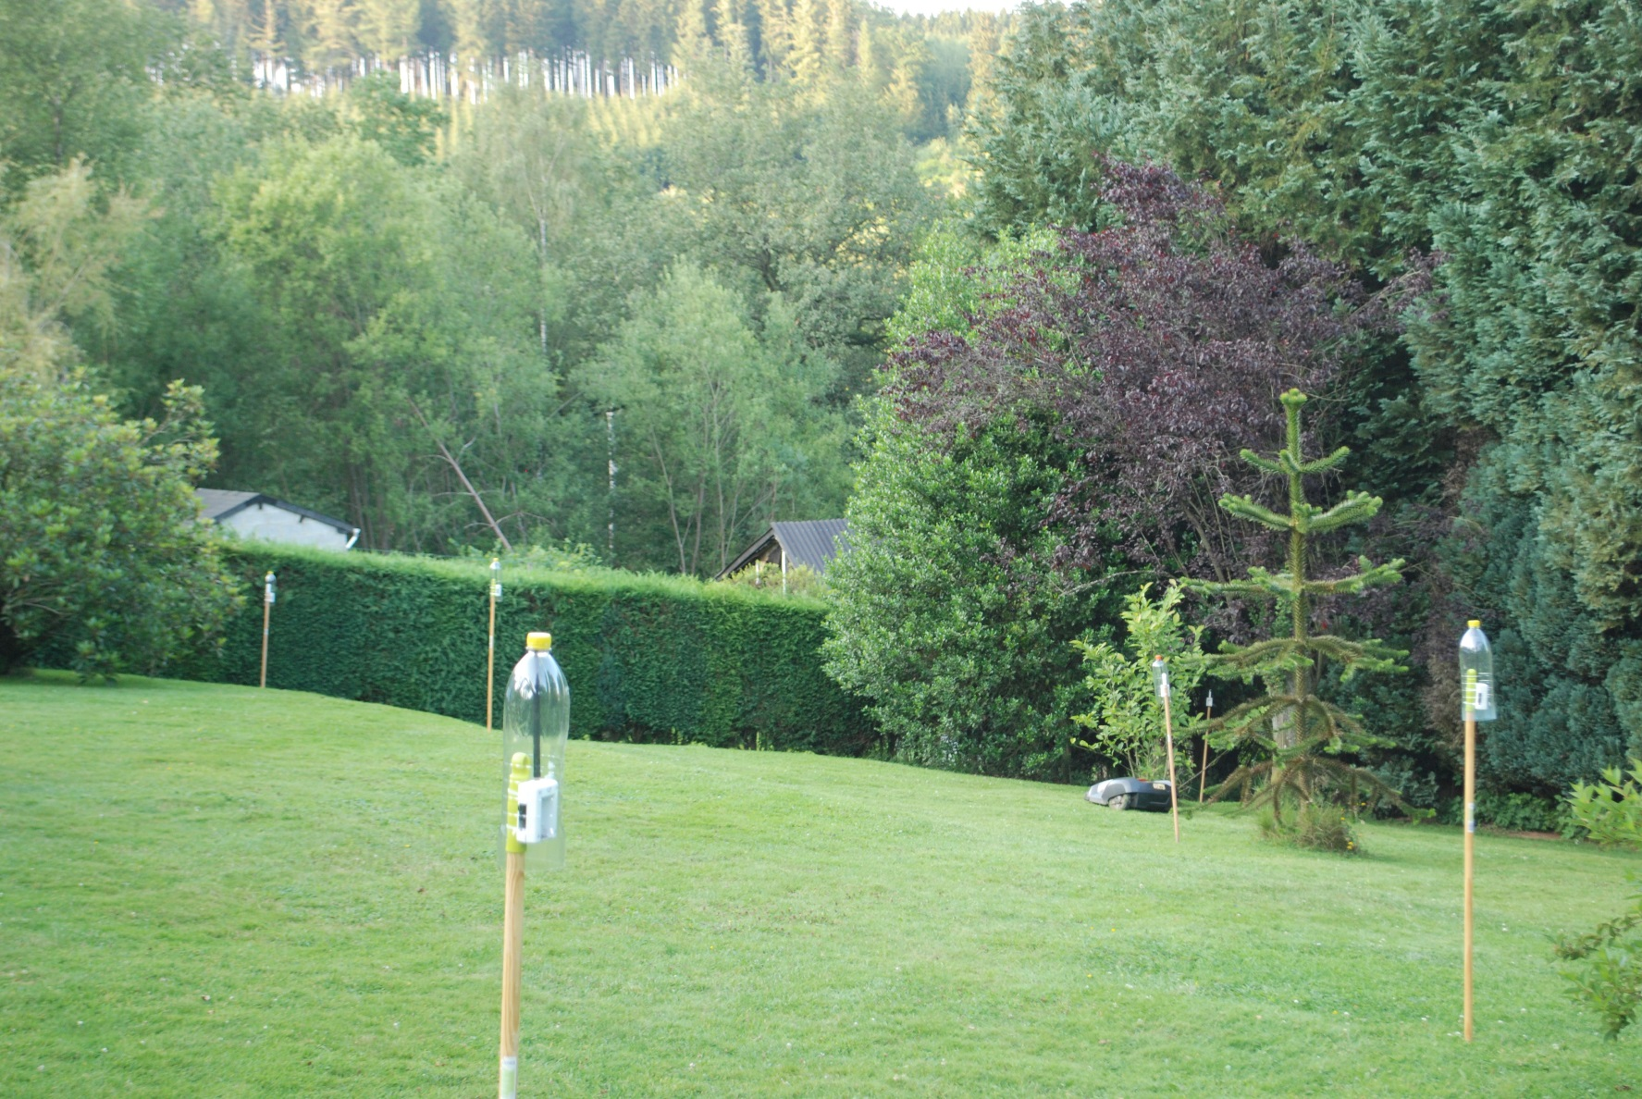
Real World Verifications
Notes:
To verify results obtained through simulations, we go to the countryside, far from radio interferences.

Slide 13
Antenna radiation patterns (patterns with former radio )
Horizontal radiation diagram of build-in antenna
Vertical whip antenna Uniform radiation horizontally
Strong attenuation
20°
Stable within
+/- 2 dB
Strong attenuation

Slide 14
Contiki RDC & MAC protocols Previous versions of Contiki
NullMAC
CSMA
NullRDC
LPP
X-MAC
ContikiMAC
Notes:
Contiki uses a MAC layer with underneath, above the physical layer, a Radio Duty Cycle layer.
For the MAC layer, two options are available:
CSMA : this is the default option, it can retransmit a frame when a collision is detected by the RDC layer.
NullMAC : this MAC layer is just an empty interface between the upper layers and the RDC layer.
For the RDC layer, 4 different options are available:
ContikiMAC: this is the default option, heavily optimized for IEEE 802.15.4 frames and the CC2420 radio.
X-MAC : Older RDC protocol, with less stringent timing constraints than ContikiMAC, but often less performing from a power point of view.
LPP : Low Power Probing is a simple, receiver initiated, RDC protocol that can be useful to understand the principles of radio-duty-cycling.
NullRDC : is an alternative RDC protocol that leaves the radio always on…
The MAC and RDC drivers are selected by means of the contiki-conf.h file.

Slide 15
Contiki CSMA MAC driver (simplified) contiki-ng/os/net/mac/csma/csma.c
Sending thread
Send packet
Iterate over queues
broadcast ?
YES
queue i empty ?
Dest = n
queue n full?
NO
NO
YES
send packet p from queue i
YES
Increment tx count packet p
send
drop
Add to queue n
NO
Ack ?
tx>max
YES
NO
YES
Return
Random delay
remove packet p from queue i
Notes:
Directly sends (through the RDC layer) broadcast packets
Puts unicast packets in a queue associated with each neighbor.
Drops packets when queue is full
Whenever possible, sends (through the RDC layer) the first packet of each queue
Removes packet from queue when packet is acknowledged
When a packet is not acknowledged or if a collision is detected, wait a random time growing linearly with the number of retransmissions and try to retransmit the packet. The linear growth stops after 3 retransmissions, and the packet is dropped. This maximum of 3 retransmissions refers to the number of times a frame is given to the RDC layer for transmission. Some RDC layers transmit themselves a frame many times.

Slide 16
Contiki NULLMAC driver contiki/core/net/mac/nullmac.c
Send packet
send
Return
Notes:
Directly sends all packets
This set of functions implements the same functions as the CSMA driver, but the functions don’t perform any task except the blind transmission of packets

Slide 17
RDC : Low Power Probing contiki/core/net/mac/lpp.c
Radio State representation :
Rx on, Tx off
Rx,Tx on
Sender wants to send
Data Frame
Sender
t
Receiver wakes up
(periodically schedulled)
Receiver
Probe (broadcasted)
Ack
Typical 125 ms
The sender spends energy while listening possibly for a full sleep period before it is allowed to send
The receiver has to broadcast its probe as it doesn’t know who is waiting to transmit a packet.
Notes:
This is an implementation of the LPP (Low-Power Probing) MAC protocol. LPP is a power-saving MAC protocol that works by broadcasting a probe frame each time the radio is turned on. If another node wants to transmit a frame, it can do so after hearing the probe from the destination receiver. To send a frame, the sending node turns on its radio to listen for probes coming from the destination.
Reference : Low power probing (R. Musaloiu-Elefteri, C. Liang, A. Terzis. Koala: Ultra-Low Power Data Retrieval in Wireless Sensor Networks, IPSN 2008)

Slide 18
RDC : LPP Broadcasting contiki/core/net/mac/lpp.c
Radio State representation :
Rx on, Tx off
Rx,Tx on
Wake-up period
Sender wants to broadcast
Sender
t
Receiver 1
Wake-up period
Receiver 2
Wake-up period

Slide 19
RDC : XMAC (simplified) contiki/core/net/mac/xmac.c
Radio State representation :
Rx on, Tx off
Rx or Tx on
Sender wants to send to x
Data Frame
Sender
t
Probe with address x
Receiver wakes up
(periodically scheduled)
Receiver
Typical 125 ms
Ack
A random delay is inserted between probes to allow other candidate senders to try their chance, a fixed delay is used in cxmac.
Receiver should stay awake longer than the longest interval between probes
Sending frequent probes during a full sleep period uses a lot of energy!
Notes:
The sender, when it needs to send a data frame, sends repeatedly a short probe that contains the destination address, leaving a random time interval between probes to allow other candidate senders to try their chance.
When the intended receiver wakes up, it answers with an Ack and stays awake.
When the sender receives that Ack, it sends its frame.
When the receiver has stored the frame it sends an Ack and returns to sleep.
Reference : Michael Buettner, Gary V. Yee, Eric Anderson, Richard Han; X-MAC: A Short Preamble MAC Protocol for Duty-Cycled Wireless Sensor Networks. SenSys’06, November 1–3, 2006, Boulder, Colorado, USA.

Slide 20
20
XMAC Broadcasting a frame
Wake-up period
Sender
t
Receiver
Wake-up period
The transmitter sends repeatedly its frame, during a period that exceeds the interval between receiver wake-ups.
When the receiver detects radio activity, it remains awake.
After receiving a complete frame the receiver returns to sleep.
Notes:
As broadcast frames can not be acknowledged (the ACKs would collide with each other) the transmitter retransmits the frame for the whole duration of a receiver wake-up cycle.
20

Slide 21
RDC : ContikiMAC 1. Sending a frame with destination address
Radio State representation :
on to Rx
on to Tx or Rx
Sender wants to send to x
Sender
t
CCA
CCA
~0.5 ms
Receiver x
Ack
~125 ms
~125 ms
The sender sends repeatedly its frame during a full sleep period or until an Ack. The receiver checks, once per sleep period, for radio activity by a double Clear Channel Assessment (CCA)
Notes:
The contikiMAC protocol implements an original radio duty cycling protocol optimized for the CC2420 radio chip.
Most of the time the receiver sleeps, but a few times per second (default value = 8) the receiver wakes up to perform two consecutive Clear Channel Assessments (CCAs) A CCA consists in switching on the radio for approximately 200µs and evaluating the level of radio activity (RSSI).
If these CCAs observe no radio-activity above a predetermined threshold the receiver returns to sleep.
The transmitter, when it has to transmit a frame, transmits that frame repeatedly, for a duration longer than the predefined sleep period of the receiver or until a frame is acknowledged.
When a CCA detects radio-activity, the receiver stays awake and waits till it has received an entire and correct frame. When that has happened, the receiver requests the transmission of an Ack and returns to sleep.
Reference :
Adam Dunkels; The ContikiMAC Radio Duty Cycling Protocol, SICS Technical Report T2011:13, ISSN 1100-3154, 2011.

Slide 22
22
Contiki RDC MAC Broadcasting a frame
Sender
t
Receiver
The receiver wakes up briefly (< 1 ms) a few times per second for checking radio activity by means of two CCAs.
The transmitter sends repeatedly its frame, during a period that exceeds the interval between receiver wake-ups.
When the receiver detects radio activity, it remains awake.
After receiving a complete frame the receiver returns to sleep.
Notes:
As broadcast frames can not be acknowledged (the ACKs would collide with each other) the transmitter retransmits the frame for the whole duration of a receiver wake-up cycle.
22

Slide 23
RDC : ContikiMAC 3. Detecting frames by Clear Channel Assessments
Radio State representation :
Rx on, Tx off
Rx,Tx on
t_{i}
Data frame
Data frame
t
Sender
CCA
Receiver wake up
One CCA is enough
CCA
CCA
t_{c}
Receiver wake up
Two CCAs are needed
The time between the two CCAs (t_{c}) must be larger than the time between two frames (t_{i}) to avoid missing a frame.
Notes:
Why is it necessary to perform two consecutive CCAs?
Between retransmissions, the sender waits a predefined time tj . If a CCA would be performed during that interval, no radio-activity would be detected, while the transmitter is attempting to get a frame through!
Therefore contikimac uses two consecutive CCAs, separated by a time interval tc larger than tj.
The receiver is woken up when a CCA detects radio activity.

Slide 24
RDC : ContikiMAC 4. Timing requirements
Radio State representation :
Rx on, Tx off
Rx,Tx on
t_{i}
t_{s}
t_{a}
Sender
Data frame
t
Data frame
Receiver
CCA
Data frame
Ack
t_{r}
t_{c}
t_{r}
t_{d}
t_{i} < t_{c} (no frame should go undetected by 2 successive CCAs).
t_{s} > t_{c} + 2t_{r} (shortest frame should be detectable).
t_{a} + t_{d} < t_{i} (Ack should preempt retransmission of frame).
t_{a} + t_{d} < t_{i} < t_{c} < t_{c} + 2t_{r} < t_{s}
Notes:
Some other constraints apply to the timing of the CCAs: the time tc between the two consecutive CCAs should be shorter than the duration of the shortest possible frame, otherwise transmission of such a frame could go undetected.
To avoid collisions between a retransmitted frame and an Ack for the just transmitted frame, the time necessary to generate the Ack on the receiver side and to recognize it at the sender side should be smaller than the time tj between successive retransmissions.

Slide 25
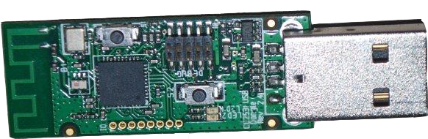
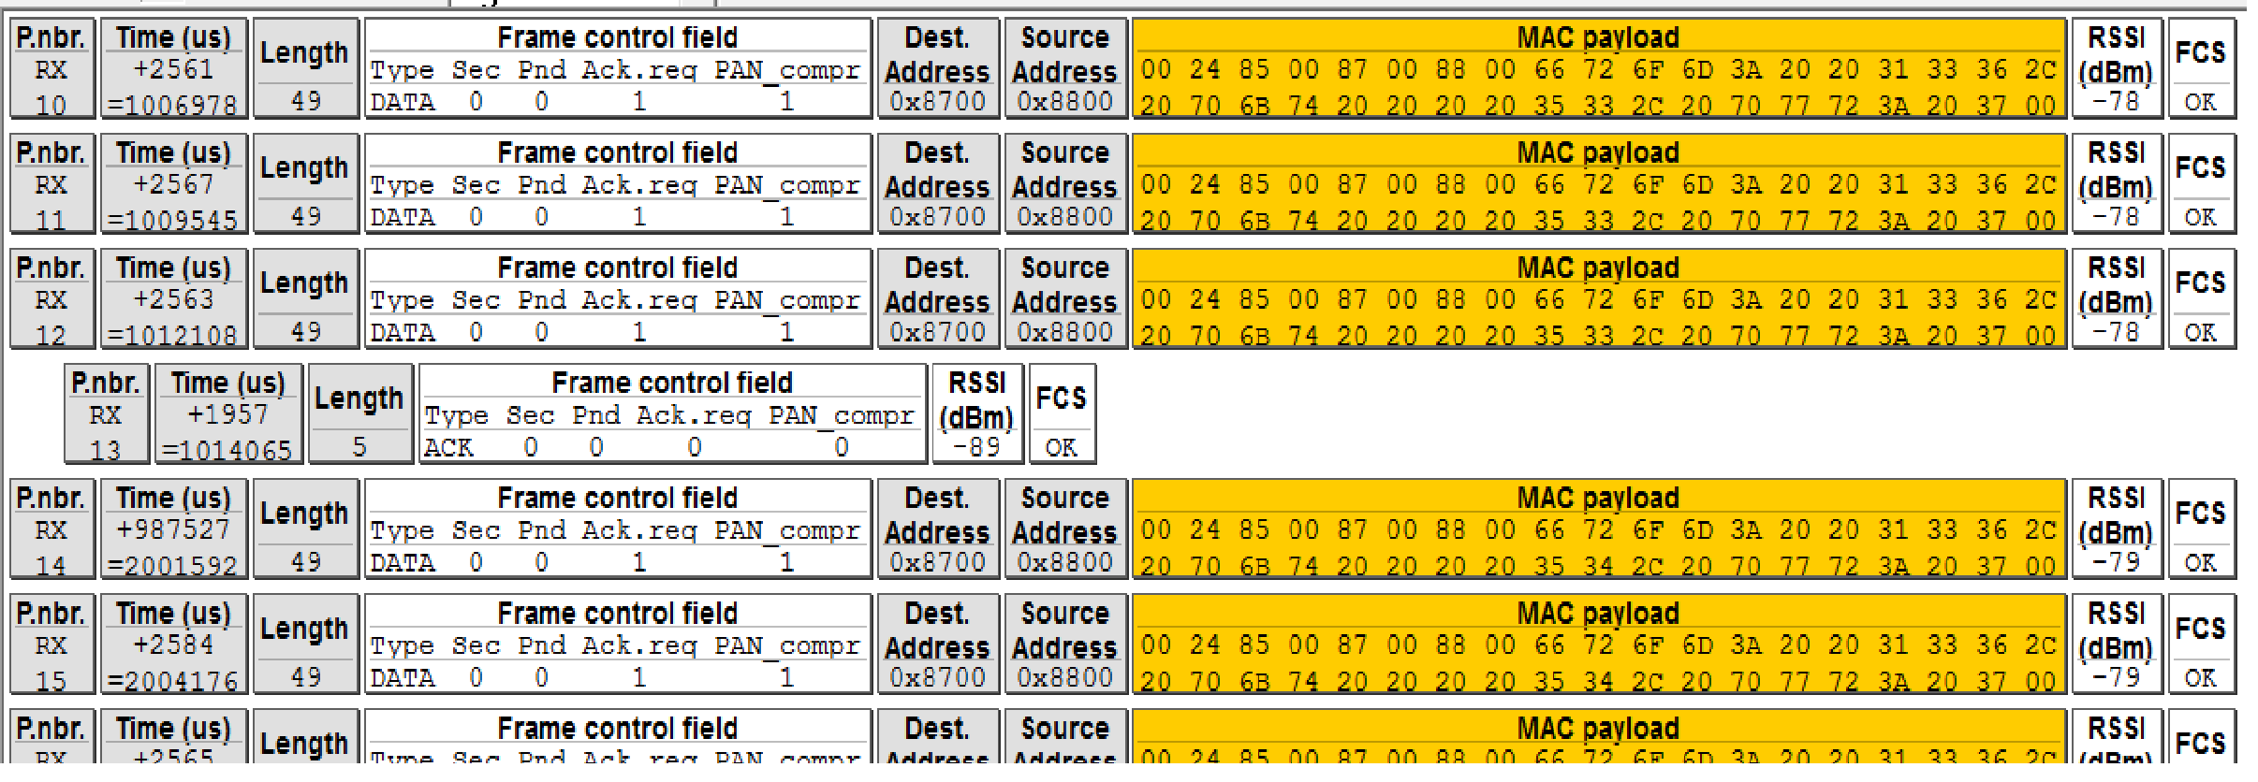
TI sniffer : CC2531
t
t_{i} = 2565 – 55*32 = 805 µs > 400 µs

Slide 26
Consequences of t_{i} > t_{c}
t_{c}
Data frame
CCA
CCA
Data frame
t
t_{i}
PDR = 100%
Data frame
Data frame
t
CCA
CCA
PDR = 100%
t
Data frame
Data frame
CCA
CCA
PDR = 0%
Data frame
CCA
CCA
Data frame
t
PDR = 100%
Data frame
CCA
Data frame
t
CCA
PDR = 100%
Data frame
Data frame
CCA
CCA
With slightly different clocks, periodic losses of consecutive packets occur!

Slide 27
Solution : increase t_{c}
t_{c}
t
Data frame
Data frame
CCA
CCA
t_{i}
But short packets may go undetected!
Padding required!
CCA
Data frame
CCA
Data frame
t
We believe this is the only good long term approach, but extensive testing, with different protocols above the MAC layer, is required

Slide 28
RDC : ContikiMAC 6. Power savings
As it was described in the previous slides ContikiMAC is not clearly better than XMAC:
- Any radio activity will wake up the receiver
Repeated transmissions of frames
uses much energy
blocks all radio traffic in the neighborhood.
But specific power saving features are included in ContikiMAC :
Fast return to sleep when wake-up was useless
Synchronization of transmissions with wake-up cycles of receivers to reduce number of retransmissions.

Slide 29
RDC : ContikiMAC 7. Fast Sleep optimizations : too long frame
Frame detection by CCA is not reliable: radio activity does not imply that somebody is sending a frame to this receiver!
Sender
Radio Noise
t
Receiver
awake
t _{max frame length} = 4.5 ms
Return to sleep
Receiver wake-up due to noise detected by CCA
Notes:
When a CCA detects radio-activity, this does not imply that an IEEE 802.15.4 frame is being received. It could result from any variety of radio transmission or noise.
As the duration of an IEEE 802.15.4 frame can not exceed 4.5 ms, the receiver returns to sleep when it did not yet observe any period of radio-silence 4.5 ms after waking up.

Slide 30
RDC : ContikiMAC 8.Fast Sleep optimizations : too long silence
Frame detection by CCA is not reliable: radio activity does not imply that somebody is sending a frame to this receiver!
Sender
Radio activity
Radio activity
t
Receiver
awake
t_{i}
Return to sleep
Radio silence
Receiver wake-up due to radio activity detected by CCA
Notes:
When data frames are being transmitted repeatedly, the time interval between successive transmissions is defined by the standard. When the receiver, after being woken-up by a CCA observes a radio-silence longer than the allowed interval between successive frames, it returns to sleep.

Slide 31
RDC : ContikiMAC 9.Fast Sleep optimizations : no frame header
Frame detection by CCA is not reliable: radio activity does not imply that somebody is sending a frame to this receiver!
Sender
Radio activity
Radio activity
t
Receiver
awake
t_{i}
No correct frame header detected! Return to sleep
Radio silence
Receiver wake-up due to radio activity detected by CCA
Notes:
After a silence of the correct duration, an IEEE 801.15.4 frame should be received. If the header of the frame being received doesn’t obey the standards rules, the receiver returns to sleep.

Slide 32
RDC : ContikiMAC 7. Transmission Phase-Lock
The sender memorizes when a receiver is awake (phase lock)
Sender wants to send to x
Observed delay for x
Before phase locking
Sender
t
Receiver x
125 ms
125 ms
Sender wants to send to x
After phase locking
Optimal delay for x
Sender
t
Receiver
125 ms
Notes:
To optimize the power at the sender side, it is desirable to minimize the number of retransmissions.
When a transmitter receives an Ack, it knows that the receiver was awake just before the transmission of the acknowledged frame. As the wake-ups occur strictly at a fixed rhythm, the transmitter can set up a table giving for each destination the optimal time to start transmitting a frame (phase locking the transmitter and receiver).

Slide 33
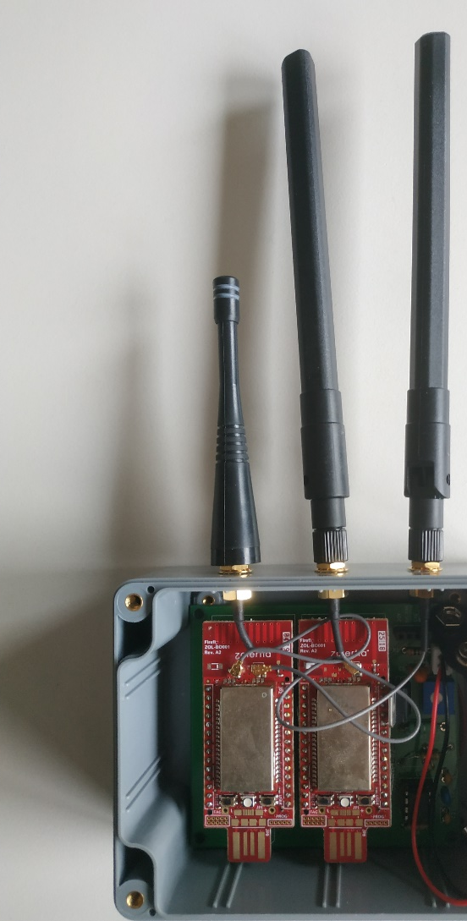
Dual Network
Two networks working in parallel
Observed network: any RPL network.
Observer network: nodes sending unicast packets for measuring latency, power usage and PDR of the RPL network.
Notes:
An observer mote is connected via ..to the mote under test (MUT). (or under study)
We want to know how many packets that the mote under study sends also arrive. The packet delivery ratio (PDR) gives the ratio of successfully received packets over the number of successfully sent packets.
We also want to know the time it takes to get a packet from application layer in MUT 1 to an application layer in MUT 2.
We also want to know the amount of power drawn by the MUT to function as if it were working without being monitored by the observer mote (OBS).
So, the influence of the measurement on the measured parameters must be negligeable.
The MUTS work on 2,4 GHz range, whereas the OBS uses a band around 868Mhz. The OBS uses CSMA over 802.15.4 physical layer on around 868 Mhz. As such we hope to form a single hop star network from OBS motes to the sink of the observer network.
The 2,4 Ghz network is shorter range and will probably operate in multi-hop fashion.

Slide 34
Performance metrics
Packet latency
Power usage
Packet Delivery Ratio (PDR)
All measurements made
With “good” radio link budgets
With default parameters in Contiki
With controlled external radio perturbations
34
Notes:
For doing reproducible measurements (reproducible circumstances under which the measurements were performed), one has to be able to control the influence of external interference. The best way to do so is to create a Faraday cage around the measurement room or to be in a rural area with almost no sources of interference (microwave ovens, WIFI etc..).
We took the approach to do the measurements in a big garden in the South of Belgium with nice neighbours that switch off their equipment on demand.

Slide 35
Packet latency
Sender application
Sender MAC layer
Radio Transmitter
Radio Receiver
Receiver MAC layer
Receiver application
tsa
Receiver sleeping
trr
Sender latency
Packet latency
tra
ack
tsr
Receiver latency
Time
35
Notes:
Application to application delay = (TSA –TSR) + (TRR– TRA) (the propagation delay is considered negligeable as the distances are so small and the bandwidth is rather low, so transmission delay will in any case be more important).
This will work as TSA and TSR are measured in the same clock. Also TRR and TRA are measured in the same clock.
35

Slide 36
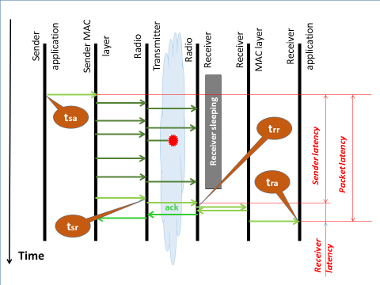
Latency Definition
t_{sa} and t_{sr} can both be derived from the local sender clock
t_{sa} can be included in the packet before sending it and t_{sr} can inserted in the last two bytes by a Contiki macro.
After receiving a packet, the receiver can compute the sender latency.
A similar mechanism allows to calculate the receiver latency.
Conclusion: by simple programming additions and 8 bytes in each packet, it is possible to compute accurately the latency of a packet over a single hop.

Slide 37
Random delay between packets
Receiver wake-ups
t
Constant but unpredictable delay
(many experiments needed for obtaining mean value)
Variable delay
(One experiment for obtaining mean value)
Notes:
As the sender clock and the receiver clock are almost synchronous, test packets at a constant frequency will have to wait a constant delay before being handled by the receiver. This delay depends only on the moment the experiment is started. To determine the average latency, a large number of identical experiments need to be done.
By sending packets at random moments, the delay incurred by successive packets will vary, and a long enough experiment will give the average delay.

Slide 38
Latency measurements
Time stamps included in packets
Synchronization of sender and receiver clocks required.
Can be used in simulated systems (COOJA) in which all mote’s clocks stay synchronized
(no clock drift)
ack
Notes:
How can we measure the time it takes to bring a packet from the observer mote to the sink (one hop communication).
We could put the time on which the packet was sent by the application, the moment that the send function is called in a packet and send it via CSMA (obs’ motes radio is always ON) the sink.
We can then measure at which time the packet arrives at the application in the sink mote and deduce both time stamps.
Unfortunately this methodology will only work when both time stamps are taken with the SAME CLOCK.
This is the case for motes in a simulator (they will all have their clocks exactly synchronised without drift).
In practice, the clock in an obs mote will not be the same as the clock in the sink mote…so we can not substract measurements done with non synchronised clocks.
The motes do have the same notion of time units though…they both measure in the same time units being clock tics or have a way to translate clockticks to the unit used in the other system (e.g. milliseconds).

Slide 39
Latency measurements
Begin and end of Sender latency included in packet
Receiver latency computed in receiver
No need for clock synchronization.
Incompatible with application level checksums
Notes:
In th

Slide 40
Latency measurements
External data logging
The application layer software generates a pulse on an I/O port. An external data-logger records these pulses.
Lost and duplicated packets cause errors

Slide 41
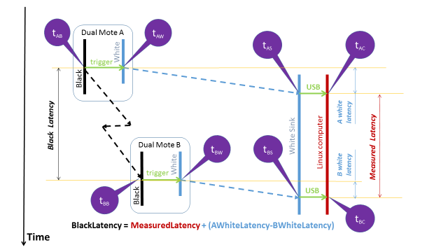
Dual Mote end to end Latency Measurements
Notes:
Black latency = Measured Latency – [(Taw2 - Taw) - (Tbw2-Tbw)]

Slide 42
Power Measurements
By software
Contiki records the time the sender, the receiver and the CPU is active. Multiplying these figures by the power consumption of these devices gives the power used.
But, power consumption figures inaccurate
To be used in simulations for comparison purposes.
By hardware
With external data logger recording mote current

Slide 43

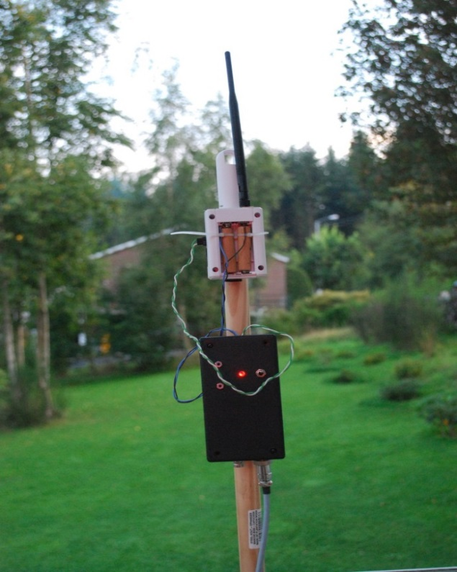
Experimental setup
Data Logger
100 Hz
4 channels
USB
To other mote
Windows 7
Pulse shaper
(12 ms)
1000μF
Differential
amplifier
2 Ω
4.5V

Slide 44
The influence of RDC and traffic
Tested link
M1
M4
USB
Sniffer
Windows
Data Logger
USB
Perturbing link
M2
(Disconnected
For power
measurements)
M3
Linux

Slide 45
Latency vs. Power
Latencies in ms, Energies in mJ/pkt
Notes:
This graph shows how RDC protocols trade latency for energy savings. The average latency of some 50 ms for all three RDC protocols is consistent with the wake-up period of 67.5 ms.
The Null RDC never switches of its receiver, explaining the very shorty latencies, and the high power consumption.

Slide 46
Latency and Power
In ms
In ms
In mJ/pkt
In mJ/pkt
Wake-up = 67.5 ms
Notes:
This graph compares the latency and power needs of ContikiMac and Xmac under various levels of perturbing traffic.
As the wake-up interval is 67.5 ms, The minimum average value for the latency is 33.75 ms. Higher values imply that some packets can not be transmitted at the first wake-up of the receiver. Even with no perturbing traffic this is surprisingly the case both for XMac and ContikiMac, but the effect is stronger with ContikiMac. An increase of the perturbing traffic should increase the number of packets that are retarded and this is clearly observed for both RDC protocols.
For power consumption, the perturbing traffic intensity seems to have little influence, but Xmac is almost 3 times more wastefull of energy.
This graph shows how RDC protocols trade latency for energy savings.

Slide 47
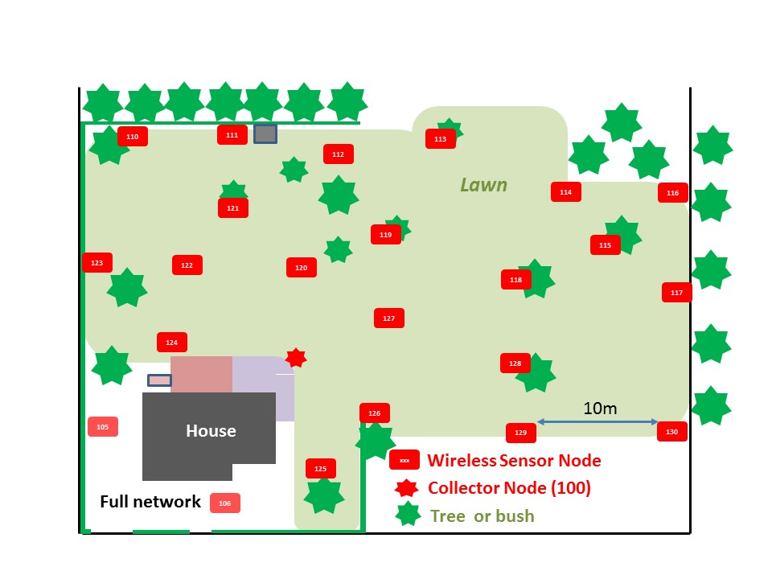
Experimental Evaluation of the performance of a RPL network

Slide 48
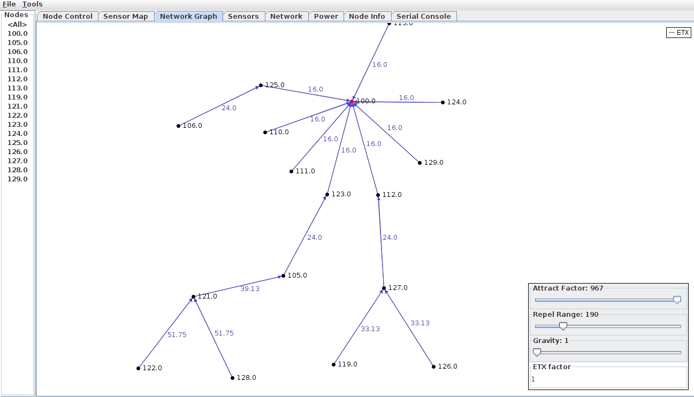
RPL networks tested with CollectView

